Slide 1
UNIT-5 The International Legislation

Slide 2
1.The Basel Convention:
The Basel Convention on the Control of Transboundary Movements of Hazardous Wastes and their Disposal is the most comprehensive global environmental agreement on hazardous and other wastes.
It was signed by 173 countries on 22 March 1989 and entered into force on 5 May 1992.
It was basically created to prevent the economically motivated dumping of hazardous wastes from richer to poorer countries, which had resulted from a tightening of environmental regulations and a steep rise in the cost of hazardous waste disposal in industrialized countries.
As of June 2023, the Basel Convention has 191 countries.
India is a member of the Basel Convention.
It ratified the convention in June 1992 and brought it into force on 22nd September 1992.

Slide 3
In the first decade (1989-1999), the Convention was primarily devoted to three agenda:
Setting up a framework for controlling the ‘transboundary’ movement of hazardous wastes, that is, the movement of hazardous wastes across international frontiers;
2. developing the criteria for ‘environmentally sound management’ (ESM); and
3. putting into place a ‘control system’ based on prior written notification

Slide 4
The 1999 Ministerial Declaration adopted at the Fifth Conference of the Parties (COP-5) set out the agenda for the current decade (2000-2010), laying special emphasis on two areas:
Building on the transboundary framework by emphasizing full implementation and enforcement of treaty commitments;
Minimization of hazardous waste generation.
It was on the 10th Anniversary of the Basel Convention on Hazardous Wastes in December 1999 that the Government Ministers assembled in Basel, Switzerland adopted a declaration on the environmentally sound management of hazardous wastes.

Slide 5
Features of BASEL Convention:
Active promotion and use of cleaner technologies and production methods.
Further reduction of the movement of hazardous and other wastes.
The prevention and monitoring of illegal traffic.
Improvement of institutional and technical capabilities— through technology when appropriate — especially for developing countries and countries with economies in transition.
Further development of regional and subregional centres for training and technology transfer.
Enhancement of information exchange, education and awareness-raising in all sectors of society.

Slide 6
Compliance and Implementation of BASEL Convention:
The Basel Convention contains specific provisions for the monitoring of its implementation and compliance.
A number of articles in the Convention oblige the Parties to take appropriate measures to implement and enforce its provisions, including measures to prevent and punish conduct that breach the Convention.

Slide 7
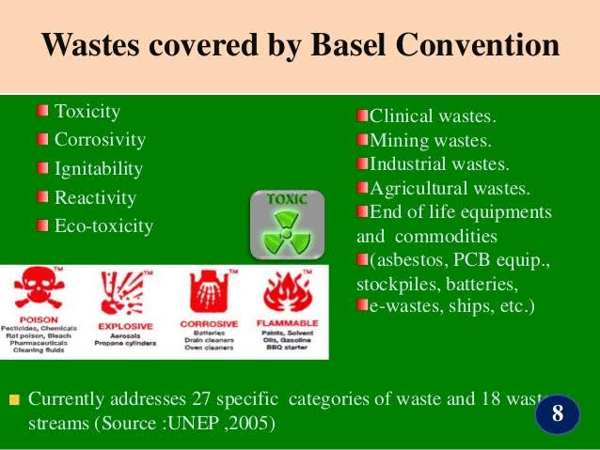

Slide 8
The Bamako Convention:
The Bamako Convention or the Bamako Convention on the Ban of the Import into Africa and the Control of Transboundary Movement of Hazardous Wastes was adopted by the twelve nations of the Organization of African Unity at Bamako, Mali in January, 1991, and came into force in March, 1999.
The Convention aims to protect human health and environment from dangers posed by hazardous wastes by reducing their generation to a minimum in terms of quantity and/or hazardous potential.
All Parties are obliged to prohibit the import of all hazardous wastes, for any reason, into Africa from non-Contracting Parties.

Slide 9
It is clear from the provisions of the Bamako Convention that the dumping of radioactive wastes, industrial wastes, sewage and sewage sludge is prohibited.
The Bamako Convention places the duty on the Parties to monitor their respective waterways to ensure that no dumping occurs.
Each State Party has to report annually to the Secretariat.
The need to sign the Bamako Convention arose from the failure of the Basel Convention to prohibit trade of hazardous waste to the less developed countries, and from the realization that many developed nations were exporting toxic wastes to Africa.

Slide 10
One important case, which occurred in 1987, concerned the import of 18,000 barrels of hazardous waste into Nigeria from the Italian companies Ecomar and Jelly Wax, which agreed to pay local farmer Sunday Nana $100 per month for storage.
The barrels, found in storage in the port of Lagos, contained toxic waste including polychlorinated biphenyls.
Their eventual shipment back to Italy led to protests closing three Italian ports.

Slide 11
What differentiates the Bamako Convention from the Basel Convention is that the former uses a format and language similar to that of the Basel Convention, but which is much stronger in prohibiting all imports of hazardous waste.
Additionally, it does not make exceptions on certain hazardous wastes like those for radioactive materials made by the Basel Convention.

Slide 12
The Rotterdam Convention:
Like the Bamako Convention, the Rotterdam Convention on the Prior Informed Consent (PIC) Procedure for Certain Chemicals and Pesticides in International Trade regulates trade in hazardous wastes but contains no commitment to reduce their use and release.
Adopted in September, 1998, the Rotterdam Convention came into force in February, 2004.
As of July, 2007, it had 73 signatories and 117 Parties.
As on date there are 140 parties.
India had acceded to the convention on 24 May 2005.

Slide 13
It is a multilateral treaty to promote shared responsibilities between exporting and importing countries in protecting human health and environment from the harmful effects of hazardous chemicals.
The Convention promotes exchange of information among Parties over a broad range of potentially hazardous chemicals that may be exported or imported.
A key goal is to provide technical assistance for developing countries and countries with economies in transition to develop the infrastructure and capacity necessary to implement the provisions of the Convention.

Slide 14
The Rotterdam Convention calls on exporters of hazardous chemicals to use proper labeling, include directions on safe handling, and inform purchasers about known restrictions or bans.
Parties can decide whether to allow or ban the import of chemicals listed in the treaty, and countries exporting chemicals are obliged to make sure that producers within their jurisdiction comply with the directions and rules.
The Parties have nine months to prepare a response concerning the future import of the chemical.
The response can consist of either a final decision— to allow import of the chemical, not to allow import, or to allow import subject to specified conditions- or an interim response.

Slide 15
Apart from the principle of Prior Informed Consent, the Rotterdam Convention highlights another principle of the Basel Convention which deals with transparency and Environmentally Sound Management (ESM) of hazardous substances.
Among the 40 chemical substances covered under the Convention, mercury compounds, polybrominated biphenyls (PBB), polychlorinated biphenyls (PCB) are also substances that are found in e-waste.

Slide 16
Waste Electrical and Electronic Equipment (WEEE) Directive in the European Union:
Among all the existing laws on wastes, a way forward has been heralded (declare/announce) by the European Union.
The European law which implements the Basel Convention in its Directives prohibits all exports of hazardous wastes from the EU members to the developing countries.
The Waste Electrical and Electronic Equipment (WEEE) Directive is the European Community directive on waste electrical and electronic equipment which, together with the Restriction of Hazardous Substances (RoHS) Directive, became European Law in February, 2003 setting collection, recycling and recovery targets for all types of electrical and electronic goods.

Slide 17
The WEEE Directive obliged the twenty-five EU member states to transpose its provisions into national law by 13 August, 2004.
By August, 2005, all member states except Malta and the UK had transposed at least framework regulations.
In May, 2001, the EU Parliament approved a directive that required producers of electronic gazettes to take responsibility—financial and otherwise—for the recovery and recycling of e-waste.
Recognizing the scope and urgency of e-waste problem, the European Union has taken the lead in addressing it by proposing an ambitious system of the Extended Producer Responsibility (EPR).

Slide 18
The EPR has been defined as,
“an environmental protection strategy to reach an environmental objective of a decreased total impact from a product, by making the manufacturer of the product responsible for the entire life cycle of the product and especially for the take back, recycling and final disposal of the product”.

Slide 19
Restriction of Hazardous Substances (RoHS) Directive:
As a legislative initiative to solve the problem of huge amounts of toxic e-waste, a Directive on the restriction of the use of certain hazardous substances in electrical and electronic equipment, namely 2002/95/EC, commonly referred to as the Restriction of Hazardous Substances Directive or RoHS was adopted in February 2003 by the European Union.
The RoHS Directive came into force with effect from 1 July 2006, and is required to be enforced and become law in each member state.
The Directive restricts the use of six hazardous materials in the manufacture of various types of electronic and electrical equipment.

Slide 20
In order to prevent the generation of hazardous waste, the RoHS Directive requires the substitution of various heavy metals, namely lead, mercury, cadmium, hexavalent chromium and brominated flame retardants like polybrominated biphenyls (PBB) or poly-brominated diphenyl ethers (PBDE) in new electrical and electronic equipment's put on the market since 1 July, 2006.
The WEEE Directive obliges a producer of electronic equipment to be responsible for the product at the end of its consumer life.
The RoHS Directive takes a step further by requiring manufacturers to phase out the use of hazardous substances in the production of electrical and electronics equipment by 2008.

Slide 21
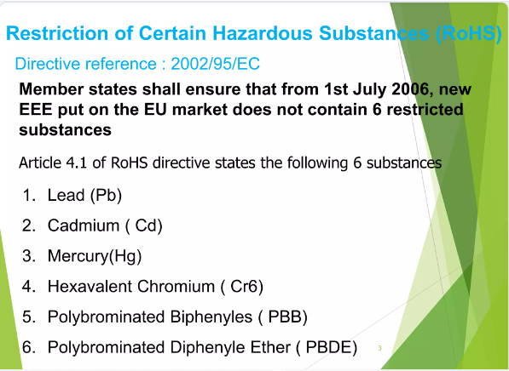

Slide 22
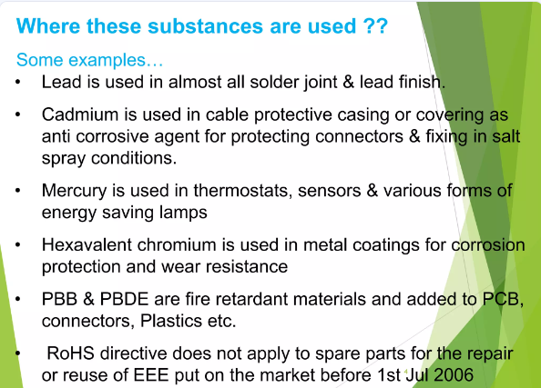

Slide 23
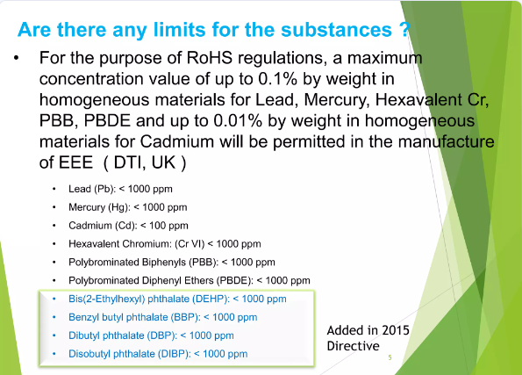

Slide 24
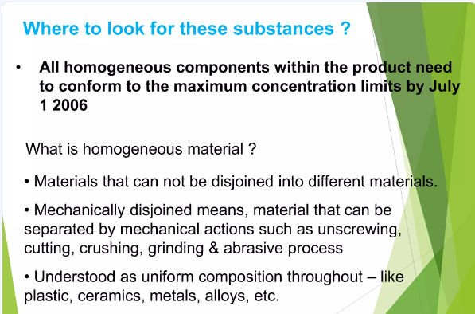

Slide 25
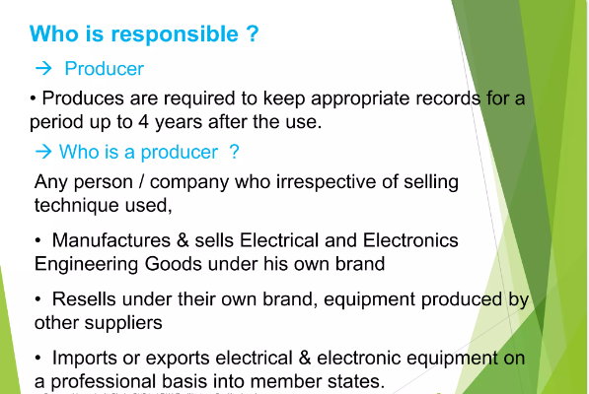

Slide 26
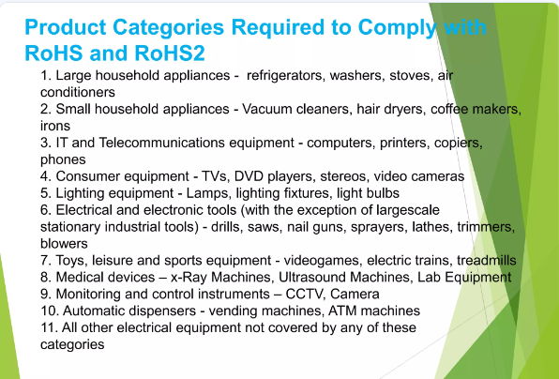

Slide 27

Thank You…

